Slide 1
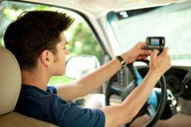
DISTRACTED DRIVING

Slide 2
Overview: distracted driving
What is distracted driving?
What are the characteristics of distracted driving?
Attitudes and Concerns
What are the laws on distracted driving?
How can you reduce distracted driving?

Slide 3
What is distracted driving?
Distracted driving occurs when a driver’s attention is diverted away from driving because they are focused on something non-driving related.
Distractions can be internal (inside the vehicle) such as reading a newspaper or eating, external (outside the vehicle) such as looking at billboards or reading road signs, and cognitive (mind off task).
Notes:
Examples of distracted driving: objects (cell-phones, CDs, food), persons (spouses, friends, children) and events (answering a call, programming navigation system)

Slide 4
Characteristics of distracted driving
Effects of distracted driving
  Reduces driver’s awareness of changes in road environment and decisions on how to respond to changes.
  Decreases driver’s ability to control vehicle.
Errors of distracted drivers
  Follow too close, fail to maintain lane position, irregular speed, run red lights.

Slide 5
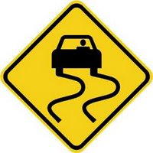
Consequences of distracted driving
  Slamming on brakes (to avoid hitting another vehicle), adjusting steering (to stay in lane).
  Near-crashes and crashes.

Slide 6
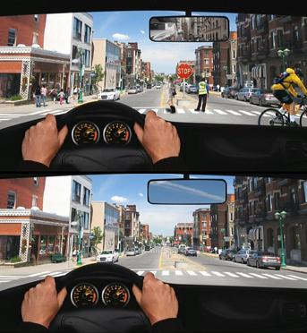
Non-distracted driver vs. distracted driver
Notes:
This image is an example of ‘inattention blindness’, meaning if a brain is distracted (by a hands free phone call or conversation with a passenger for example), half of what a driver is looking at does not register in their brain. So although a driver’s eyes are on the road, it does not necessarily mean they are registering all the important things in their field of view. Most drivers are unaware that this is happening because their distractions aren’t removing their hands from the wheel or their eyes from the road.
1st image: what an attentive driver would notice or ‘see’. 2nd image: what a distracted driver would notice or ‘see’

Slide 7
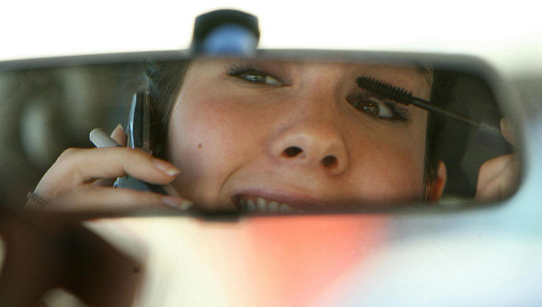
Why are distractions dangerous?
  Humans are ‘serial processors’: they can only focus their attention on one task at a time.
  The ability to multitask is a myth, people cannot multitask. When they try, none of the tasks receive the proper amount of attention.
Notes:
The task of driving requires drivers to focus their attention on steering, watching the road and reacting to changes. Adding in any other task (such as talking on the phone) can overload the brain and the task of driving suffers.

Slide 8
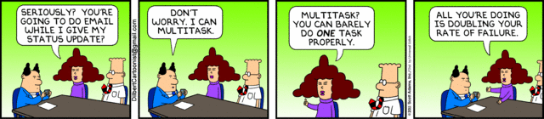

Slide 9
Crash rate of distracted young drivers
In the last five years in the United States, about 985,000 drivers under the age of 21 were involved in distracted driving crashes.
About 1.7 million drivers in their twenties have had a distraction-related crash (23% of drivers that age)*.
*Data from NHTSA 2010

Slide 10
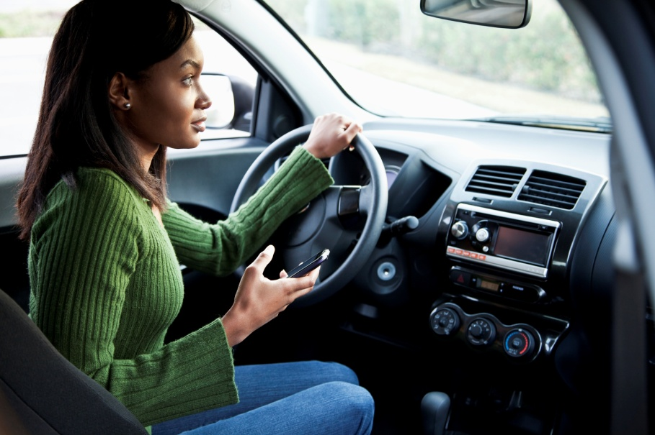
Common distractions for young drivers
The younger the driver the more likely they will engage in non-driving related tasks.
Top two distractions:
  Passengers and
  Changing the radio or song.
Also electronics.

Slide 11
Passengers
Passengers cause distractions through:
  Conversation with the driver;
  Movements or actions (e.g., play fighting);
  Social dynamic (e.g., your boyfriend or girlfriend is in the car) which can influence a driver through peer pressure or the desire to impress; and,
  Encouraging drivers to speed or take risks.
Notes:
Young drivers are up to 5x more likely to crash if they are in the car with passengers close to their own age compared to when they drive alone.
Teen males are six times more likely to perform an illegal driving move when other teen passengers are in the car.

Slide 12
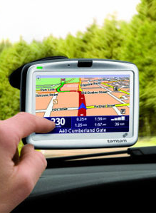
Electronics
It has been proven that using electronics (smart-phones, GPS, MP3 players) while driving increases the risk of collision.
A driver’s crash risk is 4 times (4x) higher when talking on a cell-phone.
A driver’s crash risk is 23 times (23x) higher when texting on a cell-phone.
Texting while driving has been found to be 2-5 times more risky than driving while drunk.

Slide 13
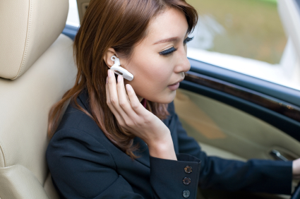
What about hands-free?
There is no evidence proving that hands-free cell-phone features (ear buds or speaker) are a safer way to use your phone while driving.
There is no evidence proving that navigation systems (GPS) or voice commands improve driver safety.
These technologies are also distracting to drivers!

Slide 14
Who gets distracted?
Young male drivers are the most likely to be distracted.
The emotional state of a driver affects their chances of being distracted.
  e.g., texting to improve a bad mood;
Content of a conversation affects driver reaction times.
  e.g., fighting on the phone distracts you from noticing a sudden stop in traffic.

Slide 15
What are the attitudes and concerns towards distracted driving?
Texting and driving was ranked number one as the most concerning issue for road safety in 2012*.
In an American study, 88.5% of respondents reported that talking on the phone while driving was a somewhat or very serious threat to their safety, compared to 56.2% of respondents who considered hands-free devices to be a threat to their safety**.
*TIRF 2012
*AAFTS 2013

Slide 16
Distracted driving laws
Most Canadian jurisdictions have banned hand-held devices while driving. Penalties range from:
  Fines ($80-$250);
  Demerit points (3-4); and,
  Licence suspension.
Some provinces have also banned hands-free cell-phone use for young drivers (BC and SK).
Notes:
Example: In Ontario, if a driver using a cell phone while driving endangers others he or she will be penalized with fines ($2,000), demerit points (6), jail time (6 months) and licence suspension (up to two years).

Slide 17
Solutions
You can develop safe driving habits to reduce distracted driving such as:
  Focusing on your driving;
  Never talk or text on a device while driving;
  Turn off your phone before driving; and,
  Don’t adjust radio/songs, read a newspaper, eat, comb hair or do any other activities while driving.

Slide 18
Distracted driving initiatives
Drop it and Drive (D.I.A.D)
  Blogs and social media to spread awareness.
  Goal to make distracted driving as socially unacceptable as drinking and driving.
Canadian Road Safety Youth Committee
  National network of youth speaking out about road issues.
  Can be used to express distracted driving concerns.

Slide 19
For more information:
www.yndrc.tirf.ca
www.caa.ca/distracteddriving/
www.dropitanddrive.com
www.youthroadsafety.ca

Slide 20
Quiz: true or false?
Distractions can be inside the vehicle but not outside the vehicle.
The top two distractions for young drivers are: passengers and changing the radio/song.
Notes:
False, distractions can be both inside and outside the vehicle
True

Slide 21
Quiz: multiple choice
Humans are serial processors. This means that:
  They can focus on two things at a time.
  They can focus on only one thing at a time.
  They can focus on five things at a time.
  They can’t focus on anything.
Notes:
Answer: B

Slide 22
Discussion
What would you do if you were in a car with a friend who talking to you while you are driving in heavy traffic?
What would you do if you were texting and driving and a friend asked you to stop?

