Slide 1
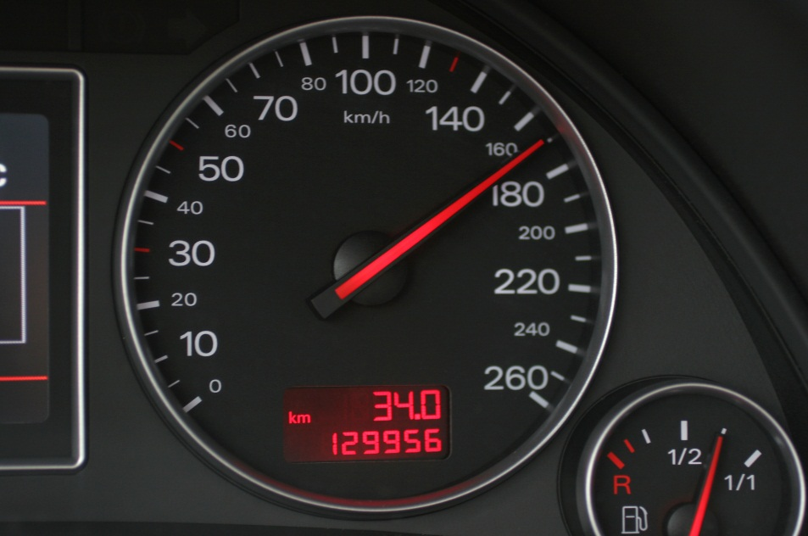
SPEEDING

Slide 2
Overview
What is speeding? What is street racing?
Characteristics of speeding: crash risk, crash types, influences and reasons
Costs to society
Legislation
Solutions

Slide 3
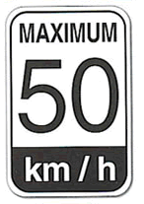
What is speeding?
Speeding:
  Driving any amount over the posted speed limit, driving too fast for conditions, or racing.
  Driving 25 km/h or more over the posted speed limit would qualify as excessive speeding.
Notes:
Driving too fast for conditions includes driving too quickly in poor weather (rain, snow, fog) or not respecting the road (taking curves too quickly, not slowing down in narrowed lanes/construction zones).

Slide 4
What is street racing?
Street racing:
  Operating a motor vehicle in a race with at least one other motor vehicle on a street, road, highway or other public place.
  Purpose is to test the limits of the vehicle and the skill/courage of the driver.
  Either a semi-organized event in a designated area with an audience or spontaneous.
Street racing is illegal and very dangerous.

Slide 5
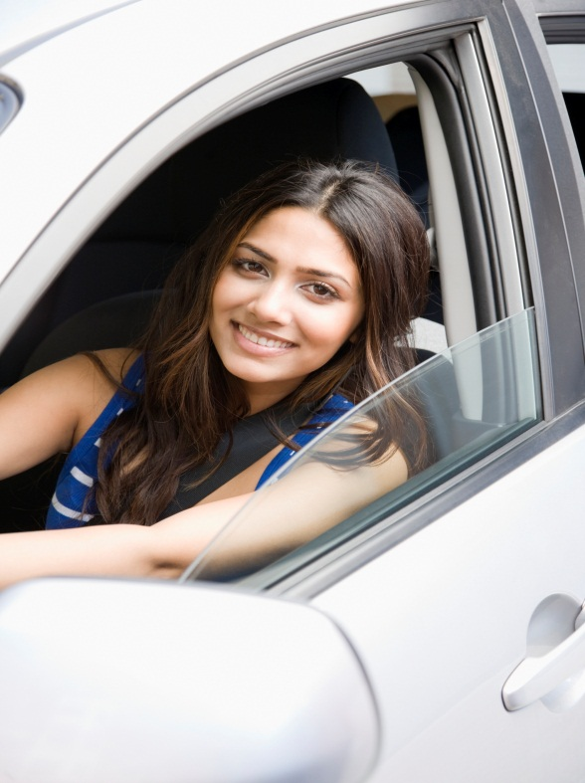
Speeding and crashes
In Canada, from 2002-2004, 40% of drivers in fatal crashes caused by speeding were aged 16-24*.
In Canada, 1 in 5 fatal crashes are due to speeding**.
In the United States, speed is a contributing factor in almost one third of all fatal crashes***.
*Data from the CCMTA 2008 RSM 2007, **Beirness and Simpson 2007, ***GHSA 2012

Slide 6
Increased crash risk
Speeding affects crash risk by:
  Decreasing the time a driver has to react;
  Increasing the distance needed to stop;
  Reducing ability to steer and manoeuvre the vehicle;
  Creating more energy that needs to be absorbed by the vehicle in a crash; and,
  Decreasing effectiveness of vehicle safety features.

Slide 7
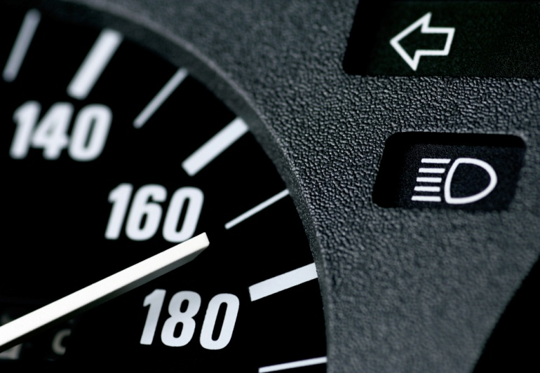
Increased crash risk
Speeding significantly increases crash risk:
  A 1% increase in speed increases a driver’s fatality risk by 4%-12%*.
  The risk of being involved in a severe crash is twice as high at 65 km/h than it is at 60 km/h**.
  *Data from the 2007 RSM, **Diamantopoulou et al. 2003

Slide 8
Speed and severity of injury
The faster a vehicle is traveling at the time of the crash, the more severe the injuries and/or likeliness of fatalities. For instance:
  Injuries from a crash at 50 km/h are equivalent to falling from a three-story building.
  Injuries from a 75 km/h crash are equivalent to falling from a seven-story building.
  Injuries from a 100 km/h crash are equivalent to falling from a twelve-story building.

Slide 9
Crashes caused by speeding
Speed-related crashes often:
  Involve a single vehicle;
  With one risk-taking driver;
  Have a vehicle run off the road and hit an object or person, or was in a head on crash;
  Generally occur between 3 pm and 9 pm; and,
  Occur in good weather with normal road conditions and in the darkness or with little light.

Slide 10
Drivers likely to speed
Young, male drivers are most likely to speed.
Other common characteristics of drivers who speed include:
  Engage in risky-driving behaviours (not wearing a seatbelt, invalid licence);
  Drive more kilometres than those who do not speed;
  Have confidence in their driving, regardless of their speed;
  Have previous speeding violations; and,
  Lack knowledge of the risks.

Slide 11
Influences of speeding
Media: “Need for Speed” is a popular trend.
  Movies (Fast and Furious) and video games (Grand Theft Auto) promote speeding/racing.
  There are never any negative consequences (death, jail time) for speeders in these movies or games.
  Studies show that risk-glorifying games promote risk taking and risky driving in teens*.
  *Data from Vingilis et al. 2012

Slide 12
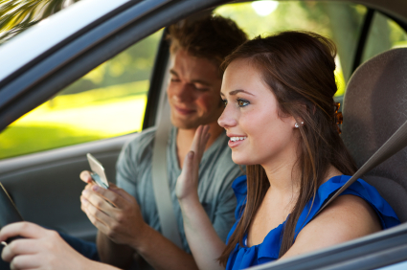
Influences of speeding
Passengers: presence of peers affect young drivers.
  Passengers encourage driver to speed or driver feels the need to impress friends or significant other by driving risky.

Slide 13
Reasons for speeding
Drivers assume they will arrive at their destination much earlier if they speed.
  Increasing speed from 70 km/h to 80 km/h to get to a destination 40 km away only reduces trip time from 34 minutes to 30 minutes but raises crash risk 60%*.
Reasons young drivers give for speeding:
  Keep up with traffic, because they are late, speed limits are too low, and it gives them a rush.
*Data from Peer 2010
Notes:
Other reasons: Drivers overestimate their own skills and assume they can handle their speeding vehicles.

Slide 14

What are the economic costs associated with speeding?
In the United States every year, the economic cost of speeding is estimated to be about $40.4 billion*.
This is equivalent to $1,281 per second.
*Fischer 2013
Notes:
Other reasons: Drivers overestimate their own skills and assume they can handle their speeding vehicles.

Slide 15
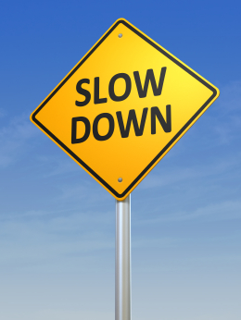
Legislation
Federal laws:
  Street racing is a criminal offence.
  Punishable by prison time.
Provincial laws:
  Each Canadian jurisdiction sets their own speeding laws and fines.
  Penalties: demerit points (6), fines (up to $10,000) and licence suspension.

Slide 16
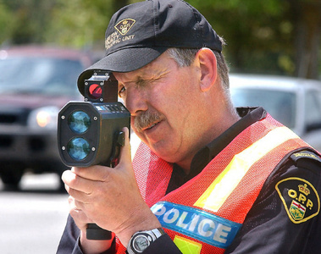
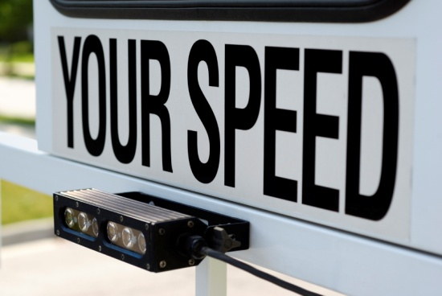
Solutions
Increase law enforcement.
  Roads patrolled by radar have a 21% decrease in injuries due to crashes*.
Electronic signs on roadside showing drivers their speed.
Cameras that capture licence plates of speeders.
*Data from Goldenbeld
and van Shagen 2005
© Guelph Mercury 2012

Slide 17
Anti-speeding campaigns
Project E.R.A.S.E
  Eliminate Racing Activity on Streets Everywhere.
  Police officers and government ministries come together to reduce street racing through education (in schools and the community) and stronger enforcement (more police targeting the issue).
SMARTRISK
  Goal is to decrease speeding, starting with new drivers.
  Help young people discover their passion for living is worth more than reckless driving.

Slide 18
For more information visit:
www.yndrc.tirf.ca/default.php
www.tirf.ca
www.yrp.ca/erase/
www.smartrisk.ca

Slide 19
Quiz: true or false
Crashes caused by speeding commonly occur between 3 pm and 9 pm.
Speeding increases crash risk by increasing the ability of the driver to steer and maneuver the vehicle.
Notes:
True
False, speeding in creases crash risk by DECREASING the ability of the driver to steer and maneuver the vehicle.

Slide 20
Quiz: multiple choice
What qualifies as excessive speeding?
  Driving 5 km/h or more over the posted speed limit.
  Driving 10 km/h or more over the posted speed limit.
  Driving 25 km/h or more over the posted speed limit.
  Driving without a seatbelt.
Notes:
Answer: C

Slide 21
Discussion
Do you think speeding 5 or 10 km/h over the speed limit should be considered speeding?
Do you think there is too much speeding in your own neighborhood?

