Slide 1
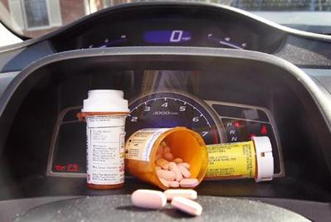
DRUGGED DRIVING

Slide 2
Overview
What is…
  What is drugged driving? How common is it?
Characteristics of the problem
  What drugs are available? How do they affect driving? How many young drivers are killed?
Legislation
  What are the laws for drugged driving?
Solutions
  How do we stop drugged driving?

Slide 3
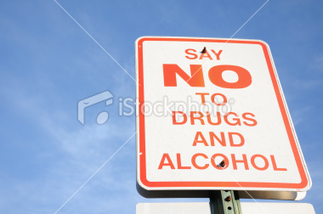
What is drugged driving?
Drugged driving: driving a motor vehicle while impaired by any type of drug or medication or combination of drugs, medication and alcohol.
  These include illegal drugs, mind-altering prescription medications and over the counter drugs that affect an individual’s ability to drive safely.

Slide 4
Prevalence of drugged driving
Drugged driving is becoming comparable to drinking and driving:
  Of the drivers who died in crashes in 2008, 41% tested positive for alcohol and 37% tested positive for drugs, meaning there were almost as many drugged drivers as drunk drivers.
Drugged driving is common among youth:
  In 2011, 21% of high school students reported driving within an hour of taking drugs.
  50% had ridden with a drugged driver*.
  *Data from CCSA 2011

Slide 5
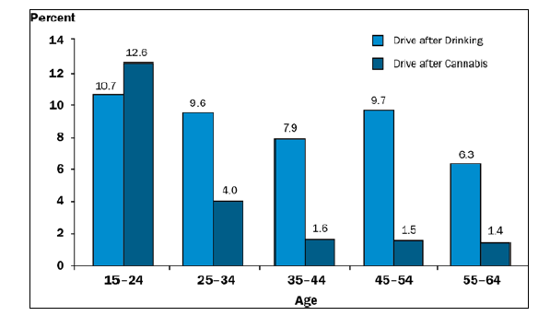
Prevalence of drugged driving
In 2011, 12.6% of those ages 15-24 admitted to driving after taking cannabis, compared to 10.7% who reported driving after drinking*.
*CCSA 2013

Slide 6
Marijuana
Marijuana is the most common drug used by youth.
  33% of Canadians aged 15-24 have used cannabis at least once this past year.
  It’s accessible, easy to hide, a quick high and undetectable by a breathalyser*.
It causes euphoria, slowed thinking, confusion, impaired learning and increased anxiety.
  Effects are felt within minutes, peak after about half an hour and last up to two hours.
*CCSA 2011

Slide 7

Other types of drugs
Illegal drugs
  Include hallucinogens, ecstasy, cocaine, crack, heroin, methamphetamines and crystal meth.
  They cause hallucinations, impulsivity, irritability, dizziness, anxiety, loss of coordination and false alertness.
  30% of high school students have taken illegal drugs*.
  *CAMH 2009

Slide 8
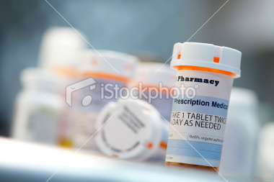

Other types of drugs
Prescription drugs
  Are not supposed to be taken without a prescription from a doctor but 33% of teens abuse these drugs recreationally*.
  Include benzodiazepine, rohypnol, oxycotin, ADD pills and sedatives.
  Cause feelings of euphoria, drowsiness, relaxation and decrease sensation of pain.
* CAMH 2009

Slide 9
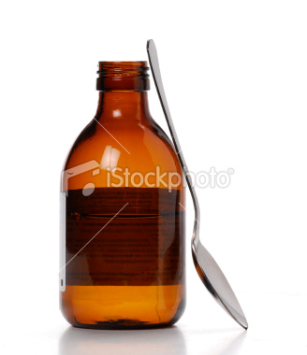
Other types of drugs
Over-the-counter drugs
  Purchased directly from pharmacy or grocery store.
  Teens overdose to feel heightened effects.
  Cold or cough medicine, Tylenol, sleeping pills, energy drinks.
  Cause intense drowsiness or stimulation.
  16% of high school students report abusing these drugs*.
  *CAMH 2009

Slide 10

Drug effects and driving
Marijuana
  Most common drug found in fatally injured drivers.
  Slows thinking, delays reaction time to changes on the road, distorts time and distance perception, making turns into oncoming traffic difficult.
  Crash risk is 2 to 6 times higher than sober drivers.

Slide 11
Drug effects and driving
Cocaine
  The second most common illegal drug found in fatally injured drivers.
  Drivers using this drug often speed, lose control of the vehicle, make unsafe turns in front of other vehicles, drive aggressively and drive inattentively.
  Crash risk is 2 to 10 times higher than sober drivers.

Slide 12
Drug effects and driving
Benzodiazepine (xanax, valium)
  Most common psychoactive drug found in drivers.
  Affects hand-eye coordination, impairs divided attention, lengthens reaction times, causes confusion and sedation.
  Crash risk is 2 to 5 times higher than sober drivers.

Slide 13
Who is most likely to drive drugged?
Young and male drivers are most likely to drive drugged.
The more frequent the drug use, the more likely a teen will drive drugged or get in a vehicle with an impaired driver.
Attitude plays a role: those who drive risky for ‘fun’ are also more likely to use drugs and drive impaired.
  Risky drivers more likely to drive drugged.

Slide 14
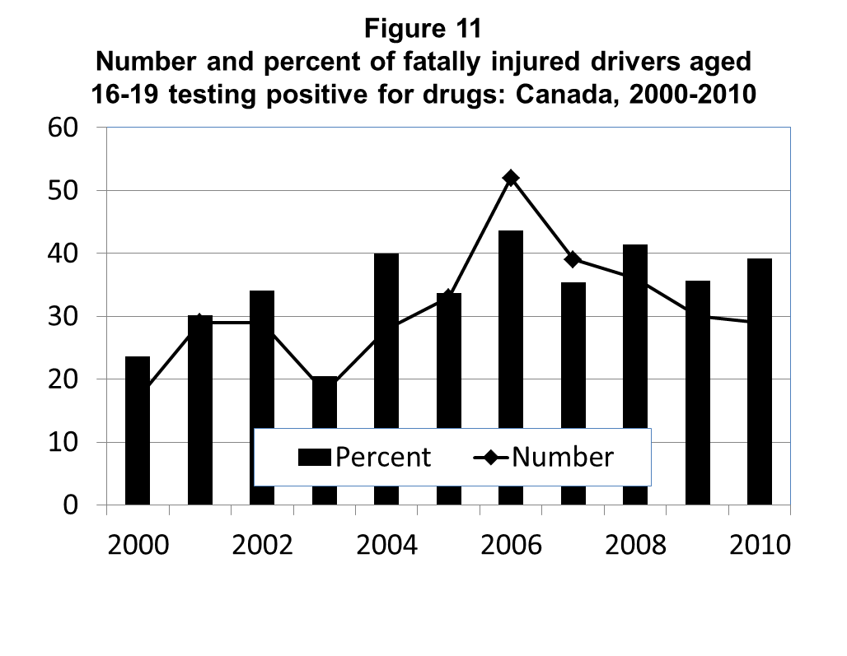
How many young drivers are fatally injured while driving drugged in Canada?
Between 2000 and 2010, the number of fatally injured drivers between the ages of 16 and 19 that were impaired by drugs increased from 23.6% to 39.2%*.
This increase could be due to the increase in the rates of drivers being tested for drugs.
*TIRF 2013

Slide 15
Young driver’s opinions
Those under 30 are the least likely age group to consider driving under the influence of drugs as a problem.
86% of young drivers agreed they could not drive home safely after drinking alcohol but only 70% felt the same about taking illegal drugs and driving home*.
Some young drivers believe that driving after taking drugs is ‘safer’ than driving under the influence of alcohol.
*Data from the 2010 Road Safety Monitor

Slide 16
Drugged driving laws
Federal impaired driving laws
  It is illegal to operate a vehicle while impaired by alcohol or drugs or a combination of both.
  Officers are allowed to run tests on drivers to check for sobriety and drug use.
  Penalties: fines ($1000) and jail time (for 2nd or 3rd offence).
Provincial impaired driving laws
  Many provinces/territories will suspend a driver’s licence if drug impairment is suspected.

Slide 17
Solutions
Alternatives to drugged driving:
  Select a designated driver at the beginning of the evening;
  Take a taxi home;
  Take public transit home; and,
  Sleep at a friend’s place.
Watch out for friends and loved ones who you know have done drugs. Refuse to be a passenger in their car and don’t let them drive.

Slide 18
Campaigns and Programs
P.A.R.T.Y program:
  The “Preventing Alcohol and Risk related Trauma in Youth” program addresses all issues related to taking unsafe risks as teens.
  Highlights the scary reality of drugged driving (crashing, paralysis, death).
“Pot and Driving” and “Why Drive High” Campaigns:
  These programs focus on eliminating the misconception that marijuana does not have negative effects on driving.

Slide 19
For more information visit:
www.yndrc.tirf.ca
www.tirf.ca
www.partyprogram.com

Slide 20
Quiz: true or false
Prescription drugs will not impair driving abilities.
Marijuana is the most common drug used by youth.
Notes:
False, prescription drugs cause driving impairment.
True.

Slide 21
Quiz: multiple choice
What are the effects of cocaine on driving?
  Aggressiveness
  Inattention
  Increasing speed
  All of the above
Notes:
Answer: D.

Slide 22
Discussion
If you saw your friends taking prescription drugs, which were not prescribed to them by their doctor, what would you say or do?

