Slide 1
VULNERABLE ROAD USERS

Slide 2
Overview: vulnerable road users
What are…
  Pedestrians, cyclists and motorcyclists.
Characteristics of the problem
  Characteristics of collisions, victims, behaviours, and issues.
Attitudes and concerns
  Opinions about vulnerable road users.
Legislation
  Existing laws that apply to vulnerable road users.
Solutions
  Protecting vulnerable road users.

Slide 3
Definition: vulnerable road users
Vulnerable road users (VRUs) are pedestrians, cyclists and motorcyclists.
  They are vulnerable because they are not protected by a vehicle and its safety features.
  They are smaller and less visible to other road users.
  They are more likely than other road users to be killed or severely injured.

Slide 4
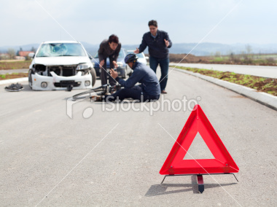
Vulnerability
  A pedestrian is 284 times more likely to be injured or killed in a car-pedestrian collision than the motorist.
  A cyclist is 150 times more likely to be injured or killed in a car-bicycle collision than the motorist.
  A motorcyclist is 50 times more likely to be killed in a car-motorcycle collision than the motorist*.
* Data from Wegman and Aarts 2006

Slide 5
Collisions involving VRUs
Vulnerable road users accounted for 22% of all road fatalities from 2004-2006.
  Pedestrians accounted for 13% of fatalities (1,089 deaths).
  Cyclists accounted for 2% of fatalities (180 deaths).
  Motorcyclists accounted for 7% of fatalities (633 deaths)*.
  *Data from Transport Canada 2009

Slide 6
Collisions involving VRUs
In Edmonton, Alberta in 2012:
  There were 296 pedestrian collisions, a slight decrease from 302 collisions in 2000.
  Bicycle collisions decreased from 214 to 177 from 2000 to 2012.
  Motorcycle collisions increased significantly from 105 in 2000 to 157*.
  *Data from City of Edmonton 2013

Slide 7
Characteristics of collisions
Pedestrian collisions commonly:
  occur on urban roads (70 km/h or less);
  occur close to a bus stop, school zone, or on a road with multiple lanes; and,
  result from pedestrians crossing a road.
Cyclist collisions commonly:
  occur on urban roads, mainly at intersections; and,
  during the afternoon rush hour period.
Motorcycle collisions commonly:
  occur on rural roads (80 km/h or higher);
  involve single vehicles that run off the road; and,
  occur in darkness/low light.

Slide 8
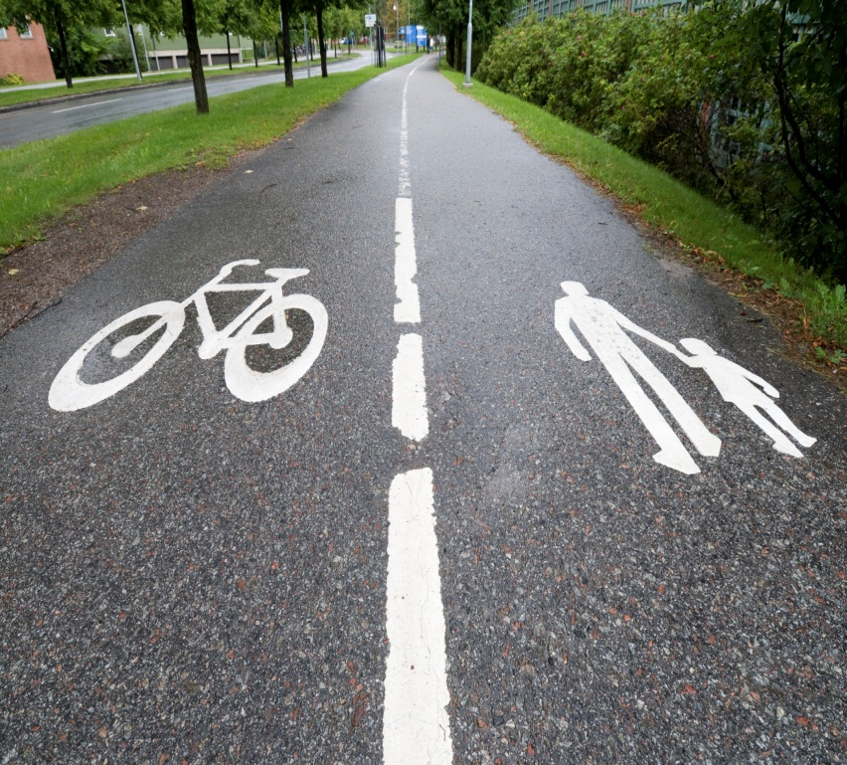
Victims of collisions
Pedestrian fatalities:
30% of victims are seniors.
62% of victims are male.
Cyclist fatalities:
18% of victims are 16 or under.
81% of victims are male
Motorcyclist fatalities:
23% of victims are 24-34.
90% of victims are male*.
*Data from Transport Canada 2009

Slide 9
Young drivers and VRUs
18% of drivers who hit and kill a pedestrian are between the ages of 16 and 24, and are likely speeding at the time*.
Hazard perception: young drivers detect fewer hazards and take longer to respond to hazards than more experienced drivers.
  This means if a pedestrian were to step out on the road unexpectedly, young drivers are less likely to notice them and brake in time.
  *Data from Transport Canada 2009

Slide 10
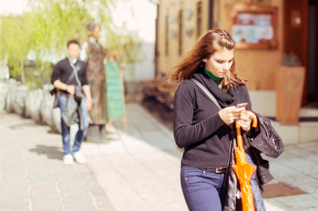
Dangerous behaviours
  Pedestrians walking while using smart phones, tablets, or MP3 players are putting themselves in danger.
  Between 2004 and 2011 injuries/deaths to pedestrians wearing headphones more than tripled.
  E.g., walking into an oncoming car because you cannot hear it.

Slide 11
Pedestrian issues
Elderly and disabled pedestrians:
  Fragile, decreased mobility and perceptual skills.
  May require a wheelchair, cane, or walker.
  May have difficulty seeing signs and hearing cues, getting across the road in time, drivers need to be more patient.
Intoxicated pedestrians:
  Walk on roadside or on the road after drinking.
  May not notice important traffic cues and may stumble or wander into oncoming vehicles.

Slide 12
Motorcycle issues
Motorcycles are becoming increasingly popular (more are on the road, drivers aren’t used to them).
High performance capabilities mean high speed and high acceleration.
Less stable when braking, less visible to other drivers due to their small size.
Difficult to estimate how close a motorcycle is to a vehicle and how quickly it is approaching an intersection.

Slide 13
Canadian’s concerns
Cyclists and pedestrians behaving unsafely are the 3rd and 2nd lowest concerns for the public.
Motorcycle driving is the least concerning to the public.
  Vulnerable road user behaviours are not very concerning to Canadians.
  This makes it difficult to increase the safety of vulnerable road users if the population is not greatly concerned about the issue*.
  *Data from 2008 Road Safety Monitor

Slide 14
Legislation
Seven provinces have mandatory helmet laws for cyclists:
  British Columbia, New Brunswick, Nova Scotia, and Prince Edward Island: all-ages law.
  Manitoba, Ontario, and Alberta: law for those under 18.
All Canadian provinces have mandatory helmet laws for motorcyclists.
All Highway Traffic Acts have laws for vehicles to respect vulnerable road users and vice versa.

Slide 15
Solutions
Pedestrians should:
  Cross only at marked crosswalks/traffic lights;
  Be alert to all traffic, especially turning vehicles;
  Steer clear of hedges, parked cars and other obstacles to remain visible;
  Avoid dashing into the street or stopping in the middle; and,
  Refrain from traveling on foot while intoxicated.

Slide 16
Solutions
Motorcyclists and cyclists should:
  Wear a helmet and protective riding gear;
  Obey the rules of the road;
  Take beginning and advanced riding lessons;
  Never drink and ride;
  Ride within limits of skill and ability;
  Allow motorists enough time to react; and,
  Be visible to motorists.

Slide 17
Solutions
Vehicle drivers should:
  Always look for pedestrians and be prepared to stop, especially on residential streets and near schools;
  Be patient if a pedestrian needs extra time to cross the road;
  Be aware that motorcycles may be going faster than they appear and may be closer than they appear; and,
  Do not speed. An increase in speed of 15 km/h results in an increase from 45% to 85% in the chances of killing a pedestrian.

Slide 18
Quiz: true or false
Most vulnerable road user fatalities are male.
Young drivers detect more hazards and are quicker to respond to hazards than more experienced drivers.
Notes:
True
False. Young drivers detect fewer hazards and take longer to respond to hazards than more experienced drivers.

Slide 19
Quiz: multiple choice
  Between 2004 and 2011 the number of injuries/deaths to pedestrians wearing headphones :
  More than tripled
  Doubled
  Quadrupled
  Decreased
Notes:
Answer: A

Slide 20
Discussion
What can you do to increase the safety of vulnerable road users?
When you are walking or biking, do you make sure to watch out for other vehicles?

