Slide 1
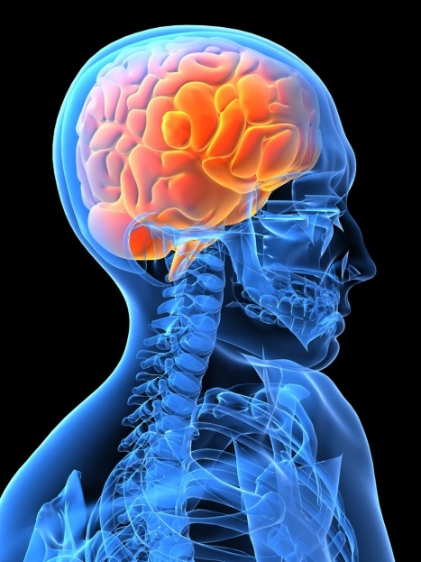
Brain Development

Slide 2
Overview:
Describe brain development
Behavioural effects of brain development
Attitudes and concerns
Solutions

Slide 3
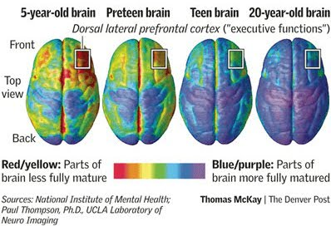
How does the brain develop?
Development begins in the womb and continues until age mid-20s.
Brain size at age 6 is 95% of adult size.
Frontal lobe continues to develop into mid-20s.
This area is responsible for planning, impulse control, reasoning and integration of information.

Slide 4
How does brain development affect adolescent behaviour?
Frontal lobe development effects mental tasks that involve thinking clearly, decision-making and impulse control
The impulsive part of the brain is almost fully developed at adolescence, which contributes to thrill seeking, irrational decisions and dangerous behaviours.
This increases the risk that teens will participate in dangerous acts, such as drinking and driving or experimenting with drugs.

Slide 5
How does brain development affect adolescent driving?
The frontal lobe is responsible for initiating and stopping attention and this is important to safe driving.
Safe driving involves skills that are underdeveloped until young drivers are in their the mid-20s, including:
  planning;
  reasoning;
  integration of information; and,
  impulse control.
Young drivers are at higher risk of distraction (e.g., by passengers, road signs and cell phones).

Slide 6

Limitations of young drivers
Hazard perception studies reveal younger drivers are less able to:
  perceive hazards;
  visually search the road; and,
  pay close attention to the entire road environment.
Voluntary eye movement is not fully developed in adolescence, making road scanning abilities weaker (Isler et al. 2009).
Young drivers are less likely to identify road safety hazards than older drivers (Oude Egberink et al. 1986).

Slide 7
Common crash types among young drivers
Single vehicle, run off the road crashes.
Head-on collisions with an oncoming vehicle occurring due to the young driver losing control of the vehicle.

Slide 8
Alcohol and brain development
The last phase of brain development occurs between ages 11 to 24.
Adolescent brains are resistant to the effects of alcohol, contributing to them drinking too much and having no desire to stop.
Early tolerance to alcohol can lead to a greater risk of alcohol abuse, mental illness and social problems in the future.

Slide 9
Drugs and brain development
Cannabis (i.e., weed, marijuana) is associated with mental illness, suicidal behaviour, and depression.
Cannabis impairs judgment, decreases concentration, and the ability to retain information.

Slide 10

Misconceptions about brain development
It has been previously thought that the brain was finished developing at age five.
Although adolescents can rationalize almost as well as adults in calm situations, stress can impair decision-making skills by teens in more emotionally charged situations.

Slide 11
What can be done to promote healthy brain development?
Prevent the use of drugs and alcohol at a young age.
Incorporate educational tools into school curricula to teach youth about the importance of brain development.
Teach youth to use calming techniques to help manage stressful situations.
Become aware of the unique needs of a young mind.

Slide 12
Parental communication
Foster an open and supportive relationship with new drivers to encourage young drivers to make good choices.
I promise program - Teen Safe Driving Initiative: intended to initiate discussion between parents/adults and their teenagers about road safety issues.

Slide 13
For more information, visit us at:
www.yndrc.ca
www.tirf.ca
Stay informed!

