Slide 1
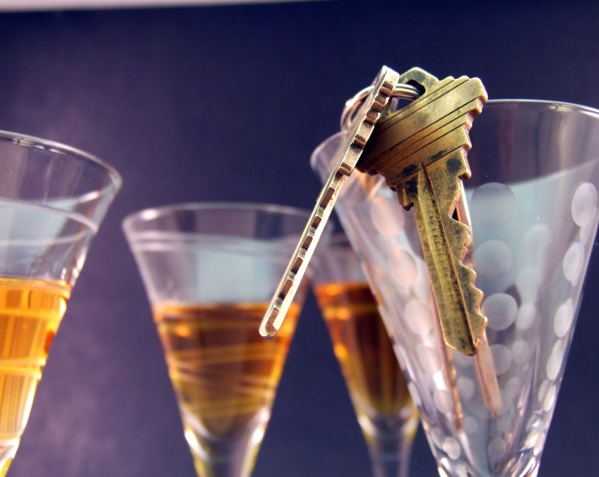
DRINKING AND DRIVING

Slide 2
Overview
What is…
What is impaired driving?
Characteristics of youth and drunk driving
Canadian youth and drunk driving
Attitudes and concerns
Understanding the risks
Legislation
Federal, Provincial, and Young Driver laws
Solutions
Alternatives to drinking and driving

Slide 3
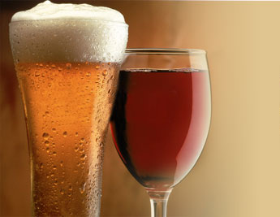
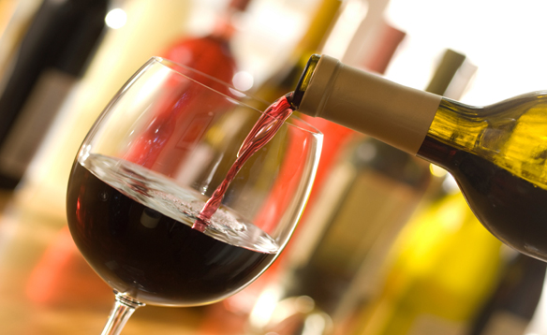
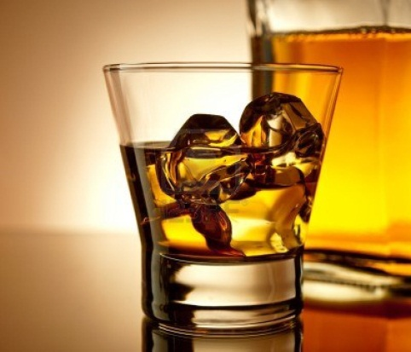
What is impaired driving?
Impaired driving
Alcohol impaired driving: driving with a blood alcohol concentration (BAC) over .08 (80 milligrams of alcohol per 100 millilitres of blood).

Slide 4
What is impaired driving?
There are two types of laws:
Per se laws: if an alcohol test shows a driver is over the legal limit of .08 he/she is charged with impaired driving.
Impairment-based laws: there must be evidence showing that the driver was not able to safely operate the vehicle because they were impaired by alcohol.

Slide 5
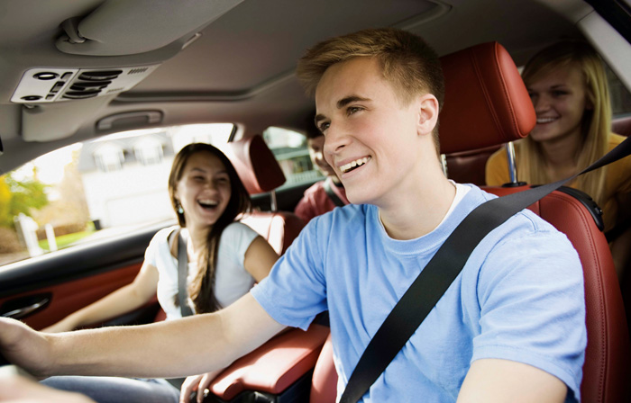
Canadian youth and drunk driving
How many young Canadians drink and drive?
12% of young drivers aged 16-24 reported they had driven within 2 hours of consuming alcohol in the past 30 days (in 2010).
8% reported they drove when they thought they were over the legal limit. Of these drivers, over half had passengers with them*.
*Data from the 2010 Road Safety Monitor (RSM)

Slide 6

Canadian youth and drunk driving
Where do young drivers do most of their drinking?
94% at a location with others (friend or relative’s house, bar, party), creating opportunities for young people to speak up to prevent drunk driving.
6% drink in their own home prior to driving*.
*Data from the 2010 RSM

Slide 7
Canadian youth and drunk driving
How many youth are killed in crashes involving a drinking driver?
In Canada in 2010, there were 510 motor vehicle deaths involving a drinking driver. Of these:
8.3% (42) were between the ages of 16 and 19;
19.9% (101) were between the ages of 20 and 25;
23.6% (120) were between the ages of 26 and 35.
*Data from the 2010 Alcohol Crash Problem in Canada

Slide 8
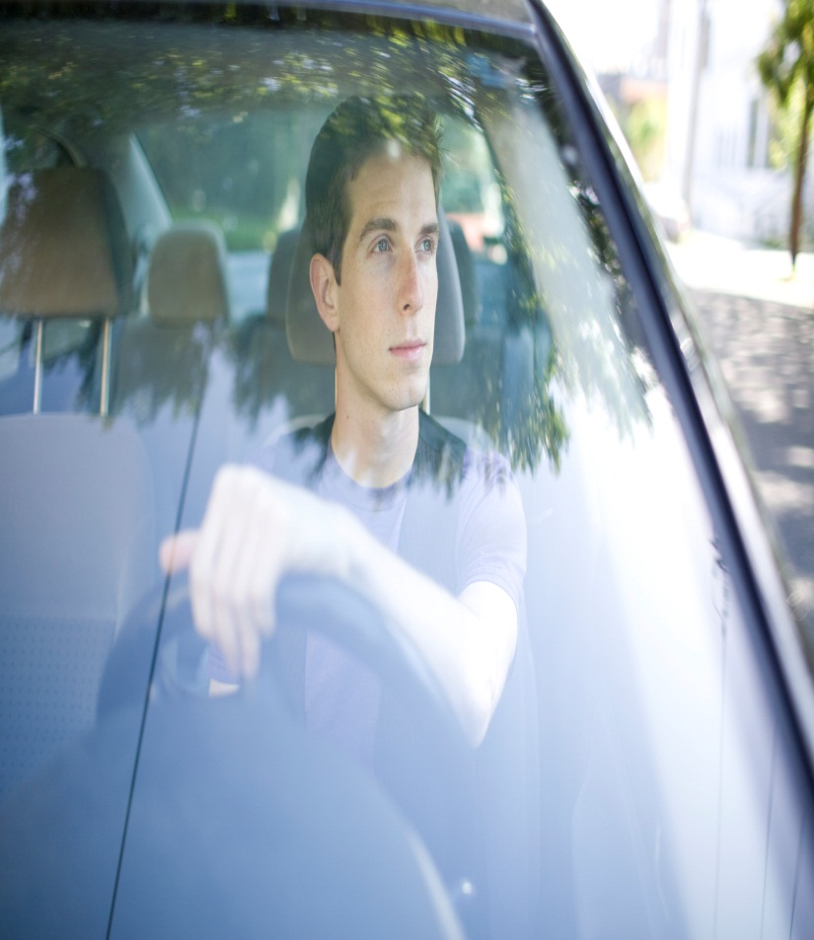
Canadian youth and drunk driving
Young drivers most likely to drink and drive: males.
In 2009, an Ontario survey of drivers in grades 10 to 12 showed that males (15%) were more likely to report driving within one hour of having two or more alcoholic drinks compared to females (8%)*.
* Data from OSDUHS 2009

Slide 9
Attitudes, concerns and perceptions
Understanding the risks of drunk driving
Young drivers aged 16 to 24 understand the dangers of drunk driving:
86% of young Canadian drivers agreed they cannot drive safely when they have been drinking alcohol (77% of adults agreed with this).
82% of young Canadian drivers think that young impaired drivers are a serious or extremely serious problem*.
*Data from 2010 RSM

Slide 10
Legislation
Federal:
The Criminal Code of Canada contains laws making it illegal to drive with a BAC over .08 or with any impairment (alcohol or drug).
Provincial:
Each jurisdiction can set its own administrative laws; many have a BAC lower than .08. Penalties include a road side licence suspension or vehicle impoundment.
(Further info: http://changetheconversation.ca/drinking and_driving_facts/offender_programs.php)

Slide 11
Legislation
Young/new driver laws:
All jurisdictions in Canada have a Graduated Driver Licencing (GDL) program with a zero BAC restriction for the first two years before a full licence.
Also, Ontario, Quebec and New Brunswick have a zero BAC requirement for all young and/or new drivers until age 21 (www.changetheconversation.ca).

Slide 12
Solutions
Young Canadian’s alternatives to drunk driving:
42% take a taxi;
40% take public transit;
34% stay at a friend’s place; and,
67% ask some one else to drive*.
Have a game plan or select a designated driver before the night begins.
Passengers can positively change a drunk driver’s behaviour by speaking up.
*Data from 2010 RSM

Slide 13
For more information:
http://yndrc.tirf.ca/default.php
www.tirf.ca
http://www.tirf.ca/publications/PDF_publications/RSM_2011_Drinking_Driving_Eng_1.pdf
http://www.ccmta.ca/english/committees/rsrp/strid/pdf/alcohol_crash09_e.PDF

Slide 14
Quiz: true or false?
Alcohol impaired driving is defined as driving with a BAC over .10.
A majority of provinces have a lower provincial BAC limit than .08.
Notes:
False, the two laws are per-se laws and impairment based laws.
True, all provinces except QC have a lower provincial BAC limit.

Slide 15
Quiz: multiple choice
Where do most young drivers do a majority of their drinking?
At school.
At a location with others.
In their home.
In their car.
Notes:
Answer: B

Slide 16
Discussion
What would you do if your friend was drinking and wanted to drive home?
How would your family or loved ones feel if they found out you’d driven while drunk?

